Slide 1
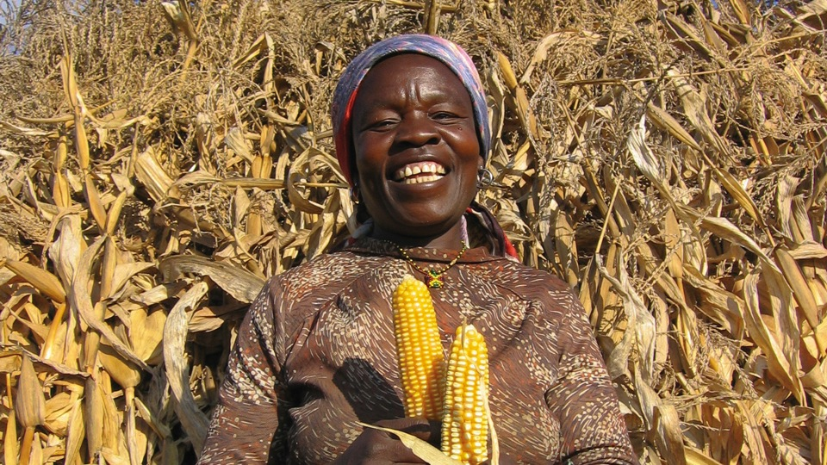

Notes:
We’re celebrating Harvest this year with a UK charity, Self Help Africa.
Self Help Africa is a charity which is working to support people in rural Africa to produce enough food to feed themselves.
This Harvest time, we can be thankful for the food we have. We can also think about millions of families in Africa who are going to bed hungry.

Slide 2
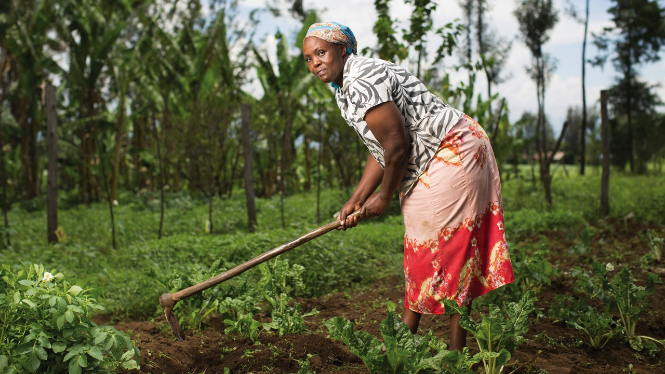
ALMOST 1 IN 4 GO HUNGRY IN SUB-SAHARAN AFRICA
Notes:
In rural Africa, many men and women struggle to feed their families.
Why? Soil is poor. Rains are erratic. People don’t have good quality seed.
It’s difficult to grow enough food to eat.
Many families eat only one meal a day. This is often a bowl of maize porridge.
There are more than 222 million undernourished people in sub-Saharan Africa. That’s almost 1 in 4.

Slide 3
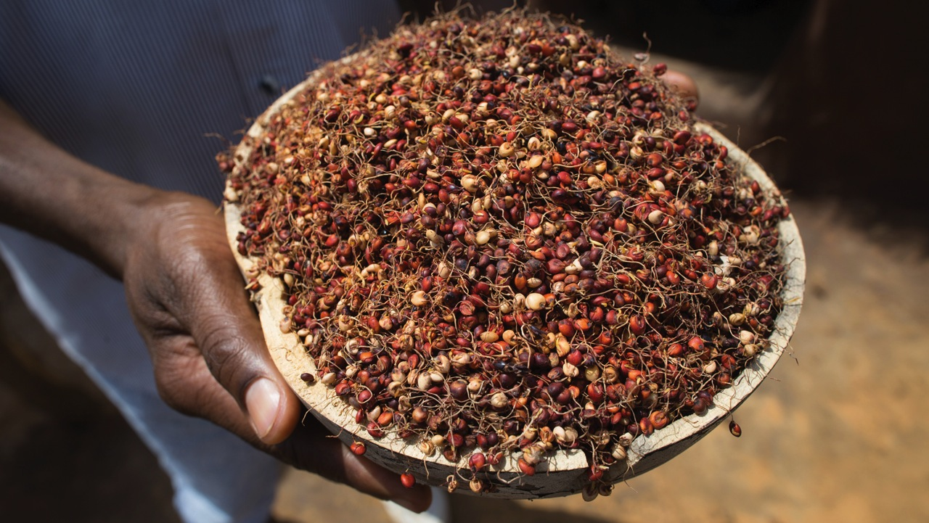
BELIYU’S
GOLDEN BEANS
Notes:
It doesn’t have to be this way. Let’s hear about some families who are escaping hunger…for good.
Beliyu is a young mother from Ethiopia. She attended a food promotion event organised by Self Help Africa as part of a project to encourage and support farmers with mung bean growing in Ethiopia’s Oromia Province.
Did you know?
Mung beans are a type of pulse
Other pulses include dried beans, lentils and chickpeas
Pulses are high in protein, fibre, vitamins and minerals
Pulses play a major role in food security, they are one of the most sustainable crops a farmer can grow. They are incredibly water efficient and keep soil fertile and healthy.
As Ethiopia faces its worst drought in recent history, the mung bean remains particularly resilient. For Beliyu and her family the benefits have been considerable.
“We used to sell mung bean and buy lentils, beans or peas. I told myself that I had spent my time selling my ‘gold for copper’. From then on I started to prepare stew using mung beans.”

Slide 4
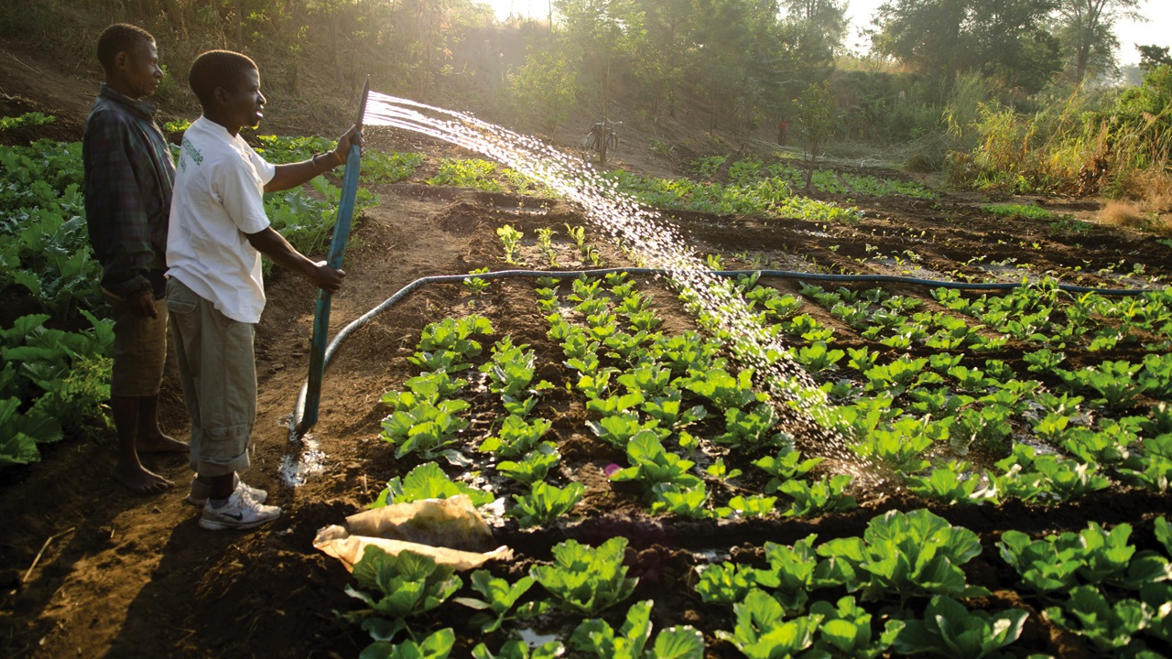
ARAGAHEGN’S
FARM
Notes:
Aragahegn lives on a small two-acre farm in southern Ethiopia.
For years Aragahegn farmed without any means of irrigation expect the rain. In an area where temperatures regularly soar to the mid-40 degrees, and where long dry periods are commonplace, he could never count on his farm to provide for his young family.
“We managed to grow just one crop annually. It was rarely enough. Nearly every year there would be months when our stocks were empty, and we needed assistance to survive.”
Three years ago he joined a Self Help Africa project to produce irrigated vegetables and grow mung beans. It transformed his life.
Aragahegn used shovels and picks to dig a well on his land, and after receiving a small loan invested in a diesel pump to draw water and irrigate his crops.
“Life has changed for my family. I have used the profits from the sale of vegetables to repay the loan I took for my pump, and since then have replaced our grass roofed tukul (hut) with corrugated iron sheeting.”

Slide 5
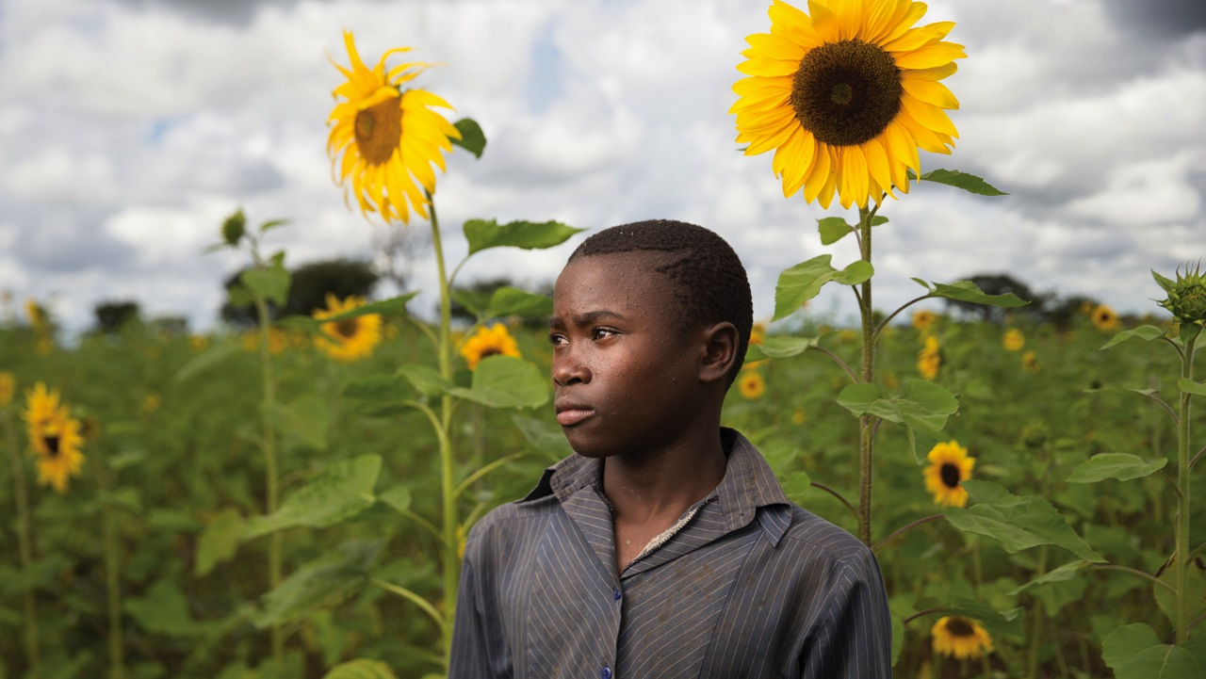
SUNFLOWER SEEDS
TO SUCCESS
Notes:
The Chamlimbana group in Eastern Zambia have doubled their earnings from sunflower production since they were organized into a producer group by Self Help Africa, three years ago.
They use a seed press to process their seed harvest into cooking oil that they bottle and sell in local markets.
They are paid more than twice the amount for oil than they received previously when they sold raw seed to middle-men who in turn sold their crop on to processors.
With their increased income group members have been able to carry out improvements to their homes, invest in livestock and pay school fees for their children.

Slide 6
Notes:
The potential of sunflowers.

Slide 7


222 million people in sub-Saharan Africa suffer from hunger
Notes:
Last year… in 2015, Self Help Africa supported more than 290,000 families across nine countries.

Slide 8
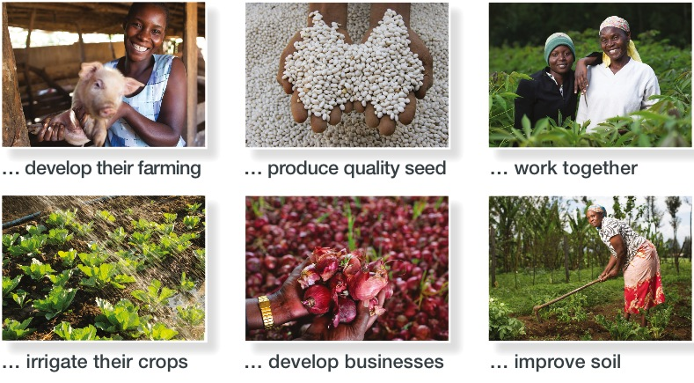
YOU’LL BE HELPING FAMILIES TO:
Notes:
They don’t give hand-outs or aid. Instead, they provide families with the knowledge and skills they need to produce enough food to feed themselves.
They show them how to use simple, practical techniques to help them to increase their harvests.
Techniques like composting, rainwater harvesting and drip irrigation. They encourage them to work together in groups to share resources and to support each other to produce more and earn more.

Slide 9
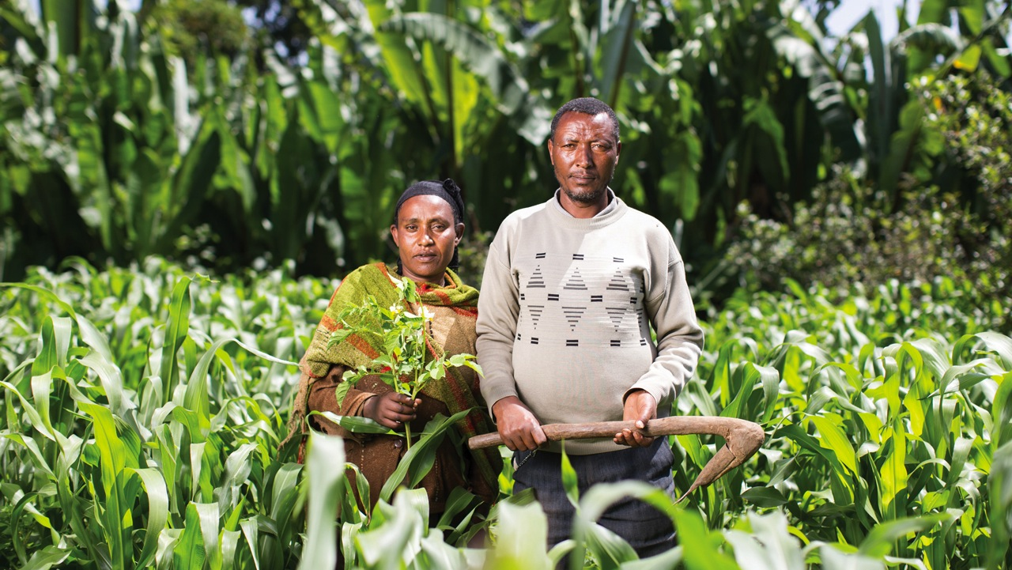
Notes:
The focus is on low-cost sustainable solutions so that communities can continue to feed themselves and develop their farming once a Self Help Africa project comes to an end.

Slide 10
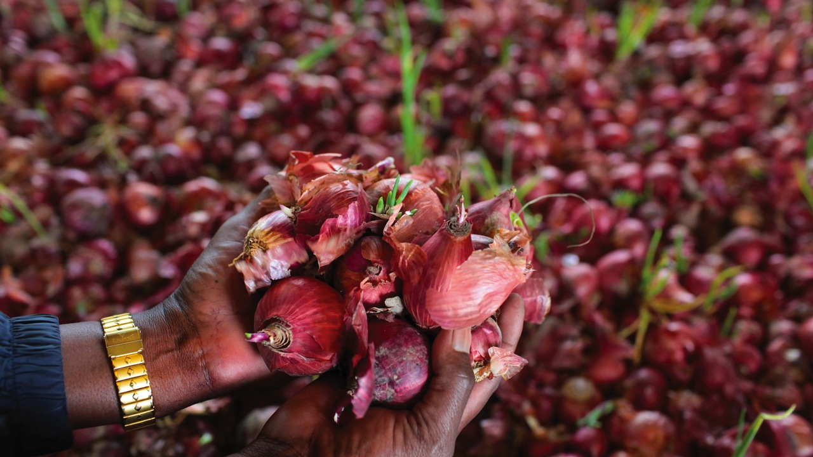
THANK YOU!
Notes:
Thank you for supporting Self Help Africa as you celebrate Harvest this year.
Thank you for helping families to feed themselves - this year and for years to come.

Slide 11
Call us: 01743 277170
Email: harvest@selfhelpafrica.org
Visit: www.selfhelpafrica.org

